Slide 1
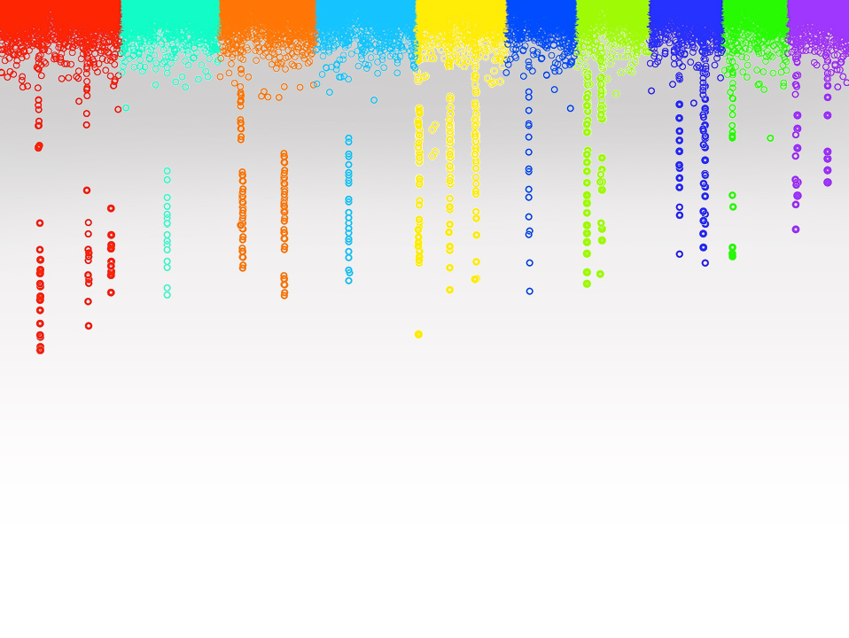

Statistical Genomics
Lecture 18: CMLM
Zhiwu Zhang
Washington State University

Slide 2
Objective
Criticism on MLM
CMLM
ECMLM

Slide 3
Hidden, observed, induction, and modeling
Genes
SNPs
PCs
y=SNP+e
y=SNP+PC+e
y=SNP+PC+K+e
y=SNP+PC+BLUP+e
BLUP=SNP+e
BLUP=SNP+PC+e
Residual=SNP+e
Residual=SNP+PC+e
Y=SNP1 + SNP2+ … + e
K
BV
BLUP
y
Residual
Hidden
Observed
Induction
Modeling

Slide 4
MLM for GWAS
Phenotype
Population
structure
Unequal
relatedness
Y = SNP + Q (or PCs) + Kinship + e
(fixed effect)
(fixed effect)
(random effect)
General Linear Model (GLM)
Mixed Linear Model (MLM)
(Yu et al. 2005, Nature Genetics)

Slide 5
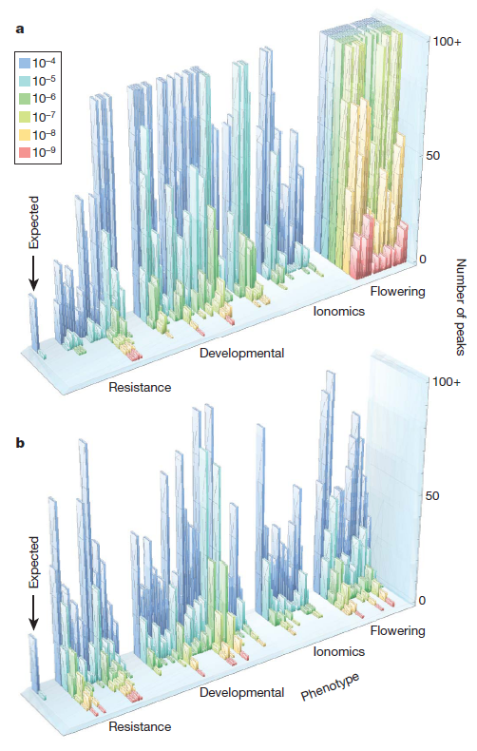

GWAS does not work for traits associated with structure
Atwell et al Nature 2010
a, No correction test
b, Correction with MLM
Magnus Norborg

Slide 6
Phenotype simulation
myGD=read.table(file="http://zzlab.net/GAPIT/data/mdp_numeric.txt",head=T)
myGM=read.table(file="http://zzlab.net/GAPIT/data/mdp_SNP_information.txt",head=T)
setwd("~/Dropbox/Current/ZZLab/WSUCourse/CROPS545/Demo")
source("G2P.R")
source("GWASbyCor.R")
X=myGD[,-1]
index1to5=myGM[,2]<6
X1to5 = X[,index1to5]
set.seed(99164)
mySim=G2P(X= X1to5,h2=.75,alpha=1,NQTN=10,distribution="norm")

Slide 7
Single marker test
y=mySim$y
G=myGD[,-1]
n=nrow(G)
m=ncol(G)
P=matrix(NA,1,m)
for (i in 1:m){
x=G[,i]
if(max(x)==min(x)){
p=1}else{
X=cbind(1,x)
LHS=t(X)%*%X
C=solve(LHS)
RHS=t(X)%*%y
b=C%*%RHS
yb=X%*%b
e=y-yb
n=length(y)
ve=sum(e^2)/(n-1)
vt=C*ve
t=b/sqrt(diag(vt))
p=2*(1-pt(abs(t),n-2))
} #end of testing variation
P[i]=p[length(p)]
} #end of looping for markers
split.screen(rbind( c(0.8,0.98,0.1, 0.98),c(0.05, 0.73, 0.1, 0.98)))
screen(1)
par(mar = c(0, 0, 0, 0))
p.obs=P
m2=length(p.obs)
p.uni=runif(m2,0,1)
order.obs=order(p.obs)
order.uni=order(p.uni)
plot(-log10(p.uni[order.uni]),
-log10(p.obs[order.obs]), )
abline(a = 0, b = 1, col = "red")
screen(2)
par(mar = c(0, 0, 0, 0))
color.vector <- rep(c("deepskyblue","orange","forestgreen","indianred3"),10)
m=nrow(myGM)
plot(t(-log10(P))~seq(1:m),col=color.vector[myGM[,2]])
abline(v=mySim$QTN.position, lty = 2, lwd=2, col = "black")
close.screen(all.screens = TRUE)
Inflation by structure

Slide 8
Add 2nd PC as covariate
PCA=prcomp(X)
y=mySim$y
G=myGD[,-1]
n=nrow(G)
m=ncol(G)
P=matrix(NA,1,m)
for (i in 1:m){
x=G[,i]
if(max(x)==min(x)){
p=1}else{
X=cbind(1, PCA$x[,2],x)
LHS=t(X)%*%X
C=solve(LHS)
RHS=t(X)%*%y
b=C%*%RHS
yb=X%*%b
e=y-yb
n=length(y)
ve=sum(e^2)/(n-1)
vt=C*ve
t=b/sqrt(diag(vt))
p=2*(1-pt(abs(t),n-2))
} #end of testing variation
P[i]=p[length(p)]
} #end of looping for markers
split.screen(rbind( c(0.8,0.98,0.1, 0.98),c(0.05, 0.73, 0.1, 0.98)))
screen(1)
par(mar = c(0, 0, 0, 0))
p.obs=P
m2=length(p.obs)
p.uni=runif(m2,0,1)
order.obs=order(p.obs)
order.uni=order(p.uni)
plot(-log10(p.uni[order.uni]),
-log10(p.obs[order.obs]), )
abline(a = 0, b = 1, col = "red")
screen(2)
par(mar = c(0, 0, 0, 0))
color.vector <- rep(c("deepskyblue","orange","forestgreen","indianred3"),10)
m=nrow(myGM)
plot(t(-log10(P))~seq(1:m),col=color.vector[myGM[,2]])
abline(v=mySim$QTN.position, lty = 2, lwd=2, col = "black")
close.screen(all.screens = TRUE)
Inflation reduced

Slide 9
Using three PCs
y=mySim$y
G=myGD[,-1]
n=nrow(G)
m=ncol(G)
P=matrix(NA,1,m)
for (i in 1:m){
x=G[,i]
if(max(x)==min(x)){
p=1}else{
X=cbind(1, PCA$x[,1:3],x)
LHS=t(X)%*%X
C=solve(LHS)
RHS=t(X)%*%y
b=C%*%RHS
yb=X%*%b
e=y-yb
n=length(y)
ve=sum(e^2)/(n-1)
vt=C*ve
t=b/sqrt(diag(vt))
p=2*(1-pt(abs(t),n-2))
} #end of testing variation
P[i]=p[length(p)]
} #end of looping for markers
split.screen(rbind( c(0.8,0.98,0.1, 0.98),c(0.05, 0.73, 0.1, 0.98)))
screen(1)
par(mar = c(0, 0, 0, 0))
p.obs=P
m2=length(p.obs)
p.uni=runif(m2,0,1)
order.obs=order(p.obs)
order.uni=order(p.uni)
plot(-log10(p.uni[order.uni]),
-log10(p.obs[order.obs]), )
abline(a = 0, b = 1, col = "red")
screen(2)
par(mar = c(0, 0, 0, 0))
color.vector <- rep(c("deepskyblue","orange","forestgreen","indianred3"),10)
m=nrow(myGM)
plot(t(-log10(P))~seq(1:m),col=color.vector[myGM[,2]])
abline(v=mySim$QTN.position, lty = 2, lwd=2, col = "black")
close.screen(all.screens = TRUE)
Inflation controlled better

Slide 10
Using breeding value as observation
y=mySim$add
G=myGD[,-1]
n=nrow(G)
m=ncol(G)
P=matrix(NA,1,m)
for (i in 1:m){
x=G[,i]
if(max(x)==min(x)){
p=1}else{
X=cbind(1, x)
LHS=t(X)%*%X
C=solve(LHS)
RHS=t(X)%*%y
b=C%*%RHS
yb=X%*%b
e=y-yb
n=length(y)
ve=sum(e^2)/(n-1)
vt=C*ve
t=b/sqrt(diag(vt))
p=2*(1-pt(abs(t),n-2))
} #end of testing variation
P[i]=p[length(p)]
} #end of looping for markers
split.screen(rbind( c(0.8,0.98,0.1, 0.98),c(0.05, 0.73, 0.1, 0.98)))
screen(1)
par(mar = c(0, 0, 0, 0))
p.obs=P
m2=length(p.obs)
p.uni=runif(m2,0,1)
order.obs=order(p.obs)
order.uni=order(p.uni)
plot(-log10(p.uni[order.uni]),
-log10(p.obs[order.obs]), )
abline(a = 0, b = 1, col = "red")
screen(2)
par(mar = c(0, 0, 0, 0))
color.vector <- rep(c("deepskyblue","orange","forestgreen","indianred3"),10)
m=nrow(myGM)
plot(t(-log10(P))~seq(1:m),col=color.vector[myGM[,2]])
abline(v=mySim$QTN.position, lty = 2, lwd=2, col = "black")
close.screen(all.screens = TRUE)
Still inflated by structure

Slide 11
Using three PCs
y=mySim$add
G=myGD[,-1]
n=nrow(G)
m=ncol(G)
P=matrix(NA,1,m)
for (i in 1:m){
x=G[,i]
if(max(x)==min(x)){
p=1}else{
X=cbind(1, PCA$x[,1:3],x)
LHS=t(X)%*%X
C=solve(LHS)
RHS=t(X)%*%y
b=C%*%RHS
yb=X%*%b
e=y-yb
n=length(y)
ve=sum(e^2)/(n-1)
vt=C*ve
t=b/sqrt(diag(vt))
p=2*(1-pt(abs(t),n-2))
} #end of testing variation
P[i]=p[length(p)]
} #end of looping for markers
split.screen(rbind( c(0.8,0.98,0.1, 0.98),c(0.05, 0.73, 0.1, 0.98)))
screen(1)
par(mar = c(0, 0, 0, 0))
p.obs=P
m2=length(p.obs)
p.uni=runif(m2,0,1)
order.obs=order(p.obs)
order.uni=order(p.uni)
plot(-log10(p.uni[order.uni]),
-log10(p.obs[order.obs]), )
abline(a = 0, b = 1, col = "red")
screen(2)
par(mar = c(0, 0, 0, 0))
color.vector <- rep(c("deepskyblue","orange","forestgreen","indianred3"),10)
m=nrow(myGM)
plot(t(-log10(P))~seq(1:m),col=color.vector[myGM[,2]])
abline(v=mySim$QTN.position, lty = 2, lwd=2, col = "black")
close.screen(all.screens = TRUE)
PCs remove inflation (many apps before MLM GWAS)

Slide 12
Using residual as observation
y=mySim$residual
G=myGD[,-1]
n=nrow(G)
m=ncol(G)
P=matrix(NA,1,m)
for (i in 1:m){
x=G[,i]
if(max(x)==min(x)){
p=1}else{
X=cbind(1,x)
LHS=t(X)%*%X
C=solve(LHS)
RHS=t(X)%*%y
b=C%*%RHS
yb=X%*%b
e=y-yb
n=length(y)
ve=sum(e^2)/(n-1)
vt=C*ve
t=b/sqrt(diag(vt))
p=2*(1-pt(abs(t),n-2))
} #end of testing variation
P[i]=p[length(p)]
} #end of looping for markers
split.screen(rbind( c(0.8,0.98,0.1, 0.98),c(0.05, 0.73, 0.1, 0.98)))
screen(1)
par(mar = c(0, 0, 0, 0))
p.obs=P
m2=length(p.obs)
p.uni=runif(m2,0,1)
order.obs=order(p.obs)
order.uni=order(p.uni)
plot(-log10(p.uni[order.uni]),
-log10(p.obs[order.obs]), )
abline(a = 0, b = 1, col = "red")
screen(2)
par(mar = c(0, 0, 0, 0))
color.vector <- rep(c("deepskyblue","orange","forestgreen","indianred3"),10)
m=nrow(myGM)
plot(t(-log10(P))~seq(1:m),col=color.vector[myGM[,2]])
abline(v=mySim$QTN.position, lty = 2, lwd=2, col = "black")
close.screen(all.screens = TRUE)
This is not silly! It works for low heritable traits

Slide 13
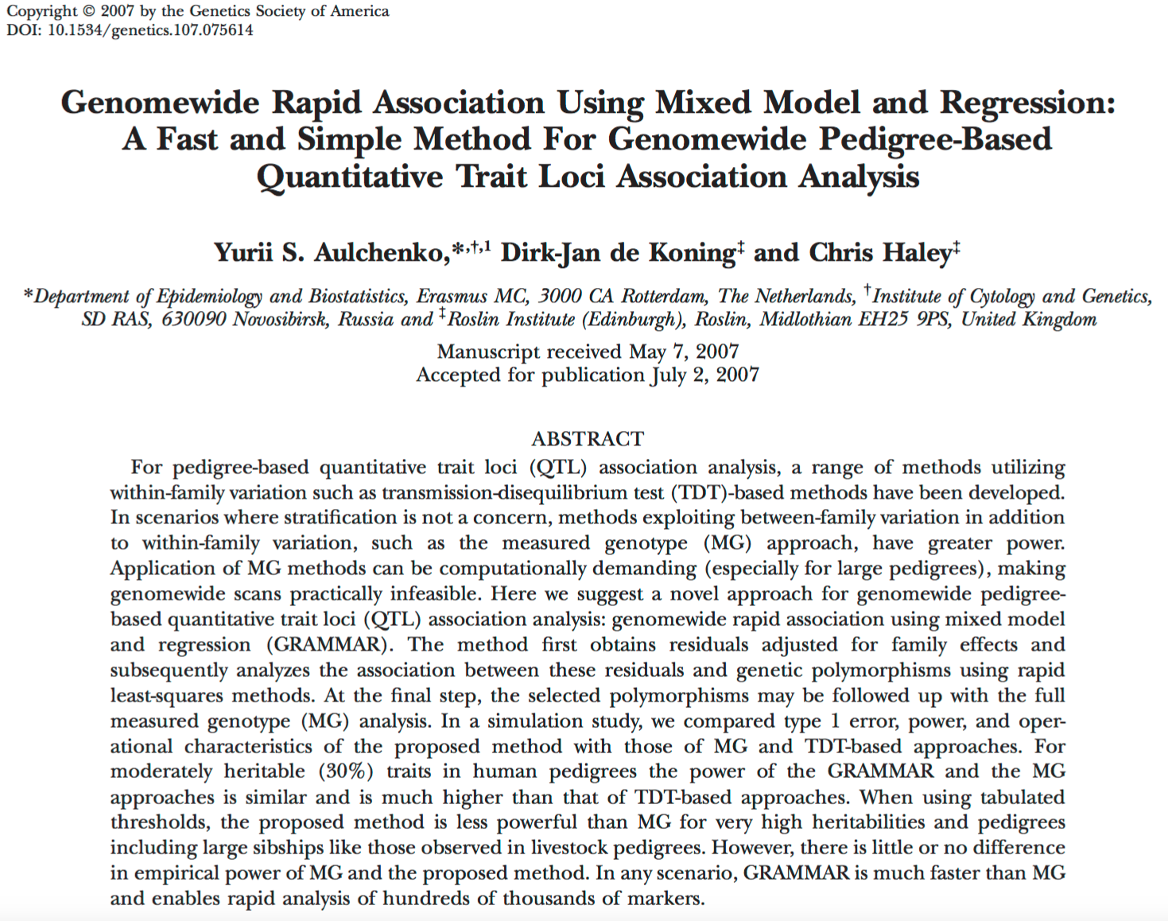

Slide 14
Using genetic effect as covariates
y=mySim$y
G=myGD[,-1]
n=nrow(G)
m=ncol(G)
P=matrix(NA,1,m)
for (i in 1:m){
x=G[,i]
if(max(x)==min(x)){
p=1}else{
X=cbind(1, mySim$add,x)
LHS=t(X)%*%X
C=solve(LHS)
RHS=t(X)%*%y
b=C%*%RHS
yb=X%*%b
e=y-yb
n=length(y)
ve=sum(e^2)/(n-1)
vt=C*ve
t=b/sqrt(diag(vt))
p=2*(1-pt(abs(t),n-2))
} #end of testing variation
P[i]=p[length(p)]
} #end of looping for markers
split.screen(rbind( c(0.8,0.98,0.1, 0.98),c(0.05, 0.73, 0.1, 0.98)))
screen(1)
par(mar = c(0, 0, 0, 0))
p.obs=P
m2=length(p.obs)
p.uni=runif(m2,0,1)
order.obs=order(p.obs)
order.uni=order(p.uni)
plot(-log10(p.uni[order.uni]),
-log10(p.obs[order.obs]), )
abline(a = 0, b = 1, col = "red")
screen(2)
par(mar = c(0, 0, 0, 0))
color.vector <- rep(c("deepskyblue","orange","forestgreen","indianred3"),10)
m=nrow(myGM)
plot(t(-log10(P))~seq(1:m),col=color.vector[myGM[,2]])
abline(v=mySim$QTN.position, lty = 2, lwd=2, col = "black")
close.screen(all.screens = TRUE)
Everything absorbed

Slide 15
Critical thinking on MLM
Computation intensive, cubic to sample size (n³)
Converge problems (h²=0 or 1)
Q(PC) and K from same set of markers, double counted
Confounded between testing marker and Q(PC) and K
Disappointed on the opposite side of inflated p values

Slide 16
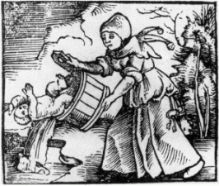
Queen + King

Slide 17

Compressed MLM
y = SNP + Q (or PCs) + Kinship +
e
y = x₁b₁ + x₂b₂+x₃b₃+x₄b₄ + Zu+
e
Group
Zhang
Zhang, Z. et al. Mixed linear model approach adapted for genome-wide association studies. Nat Genet 42, 355–360 (2010).

Slide 18
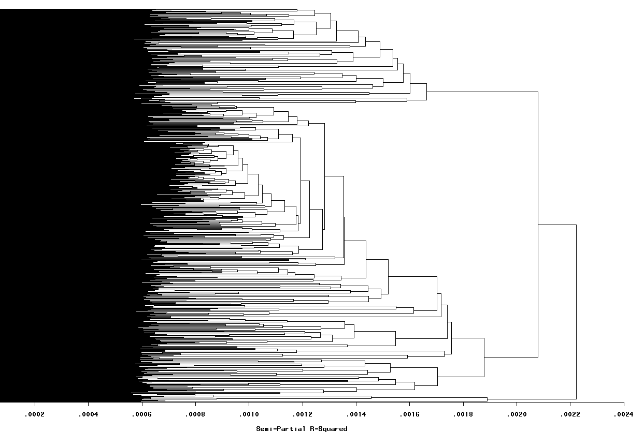
Group by kinship

Slide 19
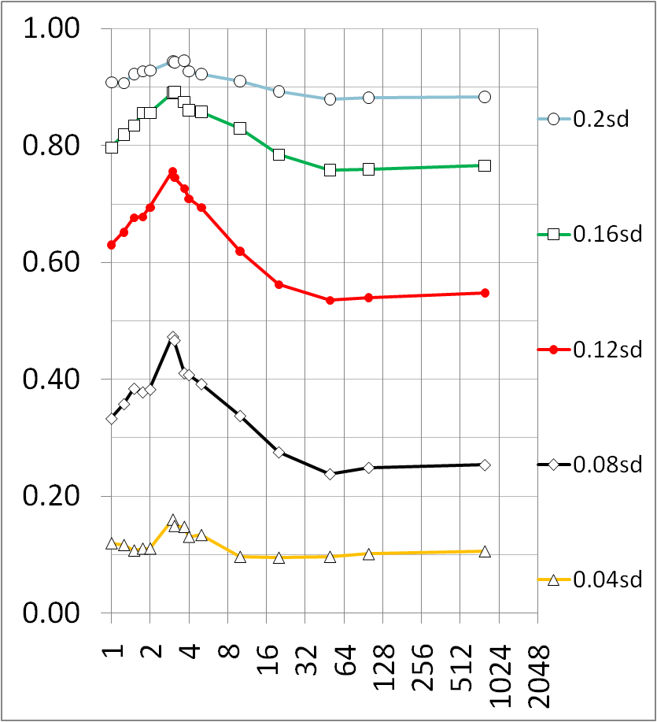
Compression improves power
Average number of individuals per group

Slide 20
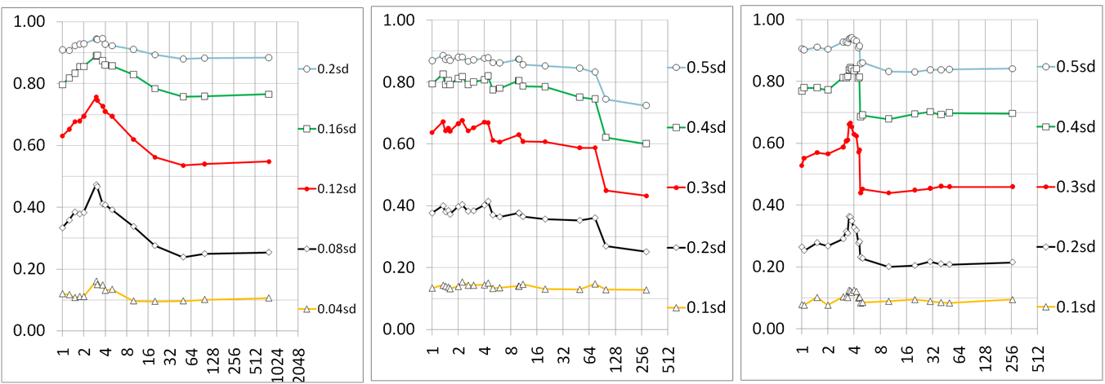
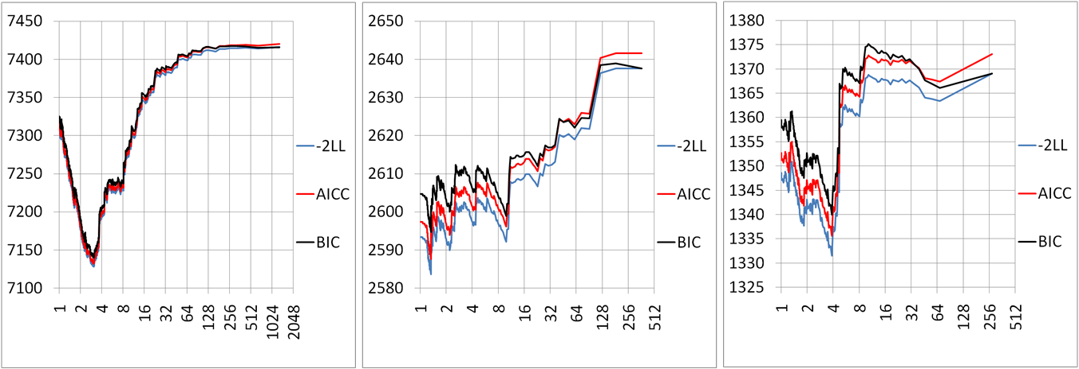
Fit matches power
Average number of individuals per group

Slide 21
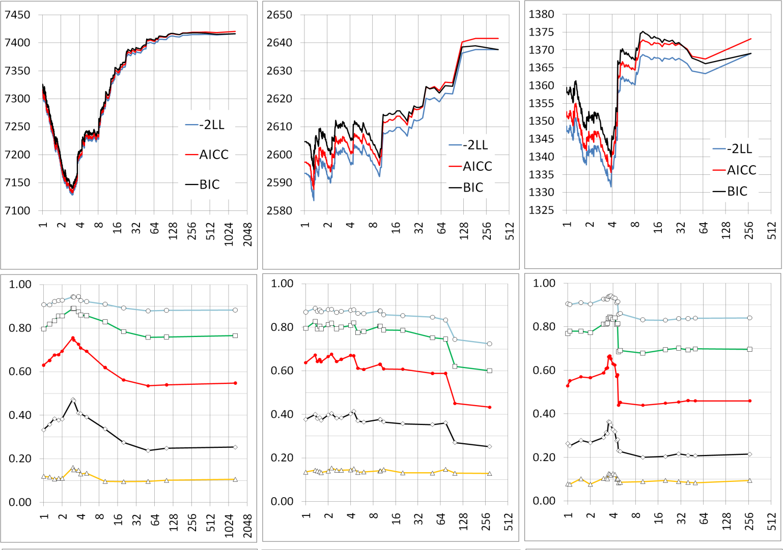
Human (n=1315)
Dog (n=292)
Maize (n=277)
Fit of Model
0.20sd (0.83%)
0.5sd (4.99%)
0.5sd (4.99%)
0.16sd (0.53%)
0.4sd (3.25%)
0.4sd (3.25%)
0.3sd (1.85%)
Statistical power
0.12sd (0.30%)
0.3sd (1.85%)
0.2sd (0.83%)
0.08sd (0.13%)
0.2sd (0.83%)
0.04sd 0(.03%)
0.1sd (0.21%)
0.1sd (0.21%)
Compression level
Compression is robust across species

Slide 22
Compressed MLM is more general
GLM
(1 group)
SA, GC, PCA and QTDT
Compressed MLM
Compressed MLM (s groups)
Sire model
n ≥ s ≥ 1
Full MLM
(n groups)
Henderson’s MLM
Unified MLM
Pedigree
based kinship
Marker
based kinship

Slide 23
Enriched Compressed MLM
Kinship: Among individuals -> among groups
1 | .167
.167 | .72
1 | .25 | .125 | .125
.25 | 1 | .5 | .5
.125 | .5 | 1 | .75
.125 | .5 | .75 | 1
Average
Maximum
1 | .25
.25 | 1
Minimum
Median
…

Slide 24
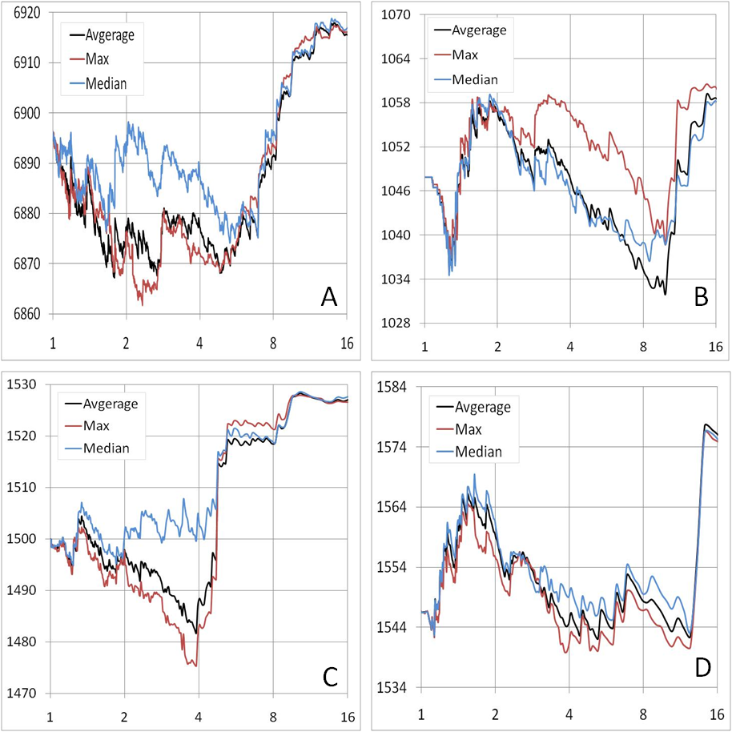
Better optimization with group kinship
A-Human
B-Dog
C-Maize
D-Arabidopsis

Slide 25
Dimensions of parameter space
5. Group method
6. Group kinship
4. Group numbers
3. Variance components
2. Kinship (BLUP)
1. Structure (BLUE)
More dimensions, better optimization

Slide 26
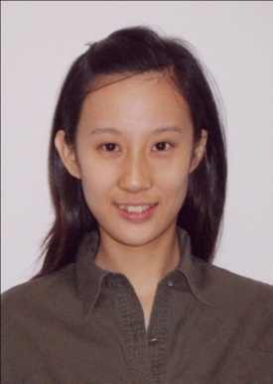
Statistical power improvement
Meng Li
Method shift | Human | Dog | Maize | Arabidopsis
GLM to MLM | 3.6% | 13.8% | 10.1% | 29.6%
MLM to compression | 4.0% | 14.2% | 7.6% | 2.5%
Compression to group kinship | 6.4% | 13.3% | 2.9% | 2.6%
BMC Biology, 2014

Slide 27
GWAS by CMLM
library('MASS') # required for ginv
library(multtest)
library(gplots)
library(compiler) #required for cmpfun
library("scatterplot3d")
source("http://www.zzlab.net/GAPIT/emma.txt")
source("http://www.zzlab.net/GAPIT/gapit_functions.txt")
setwd("~/Desktop/temp")
myY=cbind(as.data.frame(myGD[,1]), mySim$y)
myGAPIT=GAPIT(
Y=myY,
GD=myGD,
GM=myGM,
QTN.position=mySim$QTN.position,
PCA.total=3,
group.from=1,
group.to=1000000,
group.by=10,
memo="CMLM")

Slide 28
Highlight
Criticism on MLM
CMLM
ECMLM

